Slide 1


Bank of Baroda Hackathon - 2022
Technology Partner
Your Team Name : Keyboard crackers
Your team bio :Think positive
DATE : 20.09.2022

Slide 2
Problem Statement?
Nowadays passwords can be easily cracked, and they are no secured
To try and make password more secure, consumers are asked to make them more complex, by using numbers, uppercase, lowercase letters and special characters. This makes the people hard to remember.
If suppose a strangers person knows our password they can hack it easily.
To provide solutions for customer with our new ideas
We intersted in problem solving so we give creative ideas for customers problem

Slide 3
User Segment & Pain Points
Both clients and banks need an easy, secure, fast and convenient way to ensure the security of transactions as passwords are not reliable or secure in practice
Authentication processes generally require a valid identity (e.g., username) along with one or more authentication factors (e.g., password, pin, physical smart card, token generator, etc.).
We inspire from phone screen lock(eg.Alternate password)
If we forget our pin we can use alternate password (For eg.Name,Pin,address,etccc..,

Slide 4
Pre-Requisite
Alternate password can be solution for Forget or wrong pin
Eg.If we forget our pin or put wrong pin we can put our alternative password or pin we already given for alternative..

Slide 5
Azure tools or resources
° Azure portal ° Azure cloud shell ° Azure power shell ° Azure CLI

Slide 6
Any Supporting Functional Documents
∆ It is alternate way for forget our pin
∆It is already used in phone secure systems so it is easy and accesible
∆Alternate password is also the best way to access

Slide 7
Key Differentiators & Adoption Plan
Our idea is such a creative for solving problem ,Till the days alternative passwords are not used in banks and atm’s .
May our idea will be used for solving the problem to alternative authentication

Slide 8
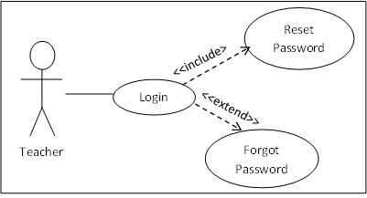
GitHub Repository Link & supporting diagrams, screenshots, if any

Slide 9
Thank You
Team member names
VIGNESH M
SANDHIYA M
SRIRAM A

